Slide 1




MENTORNESS
IPL
ANALYSIS

Slide 2



WHAT IS IPL?
The Indian Premier League (IPL) is a professional Twenty20 cricket league in India, established in 2008 by the Board of Control for Cricket in India (BCCI). It features franchise teams representing different Indian cities, attracting top international and domestic players, and is one of the world's most-watched and lucrative cricket leagues.

Slide 3
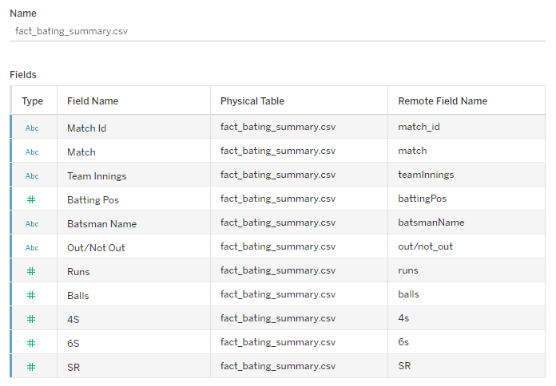
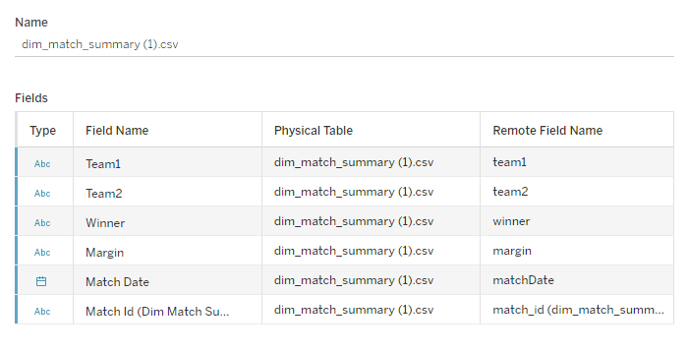
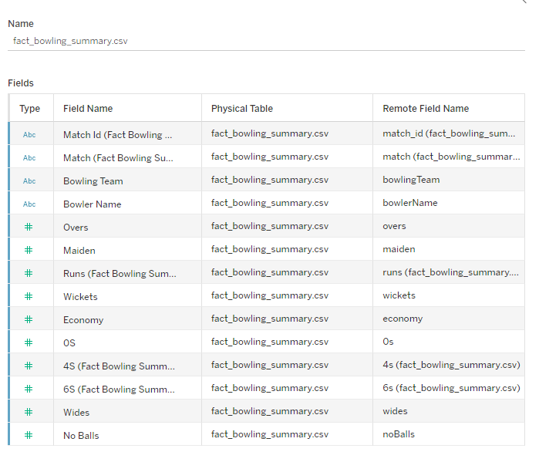
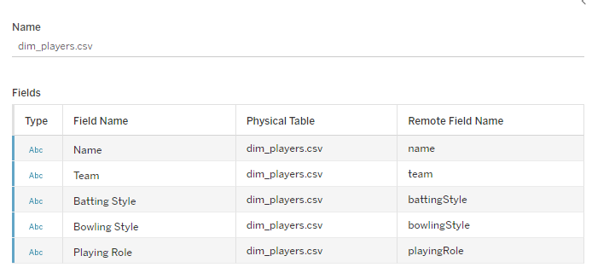
Datasets Provided

Slide 4
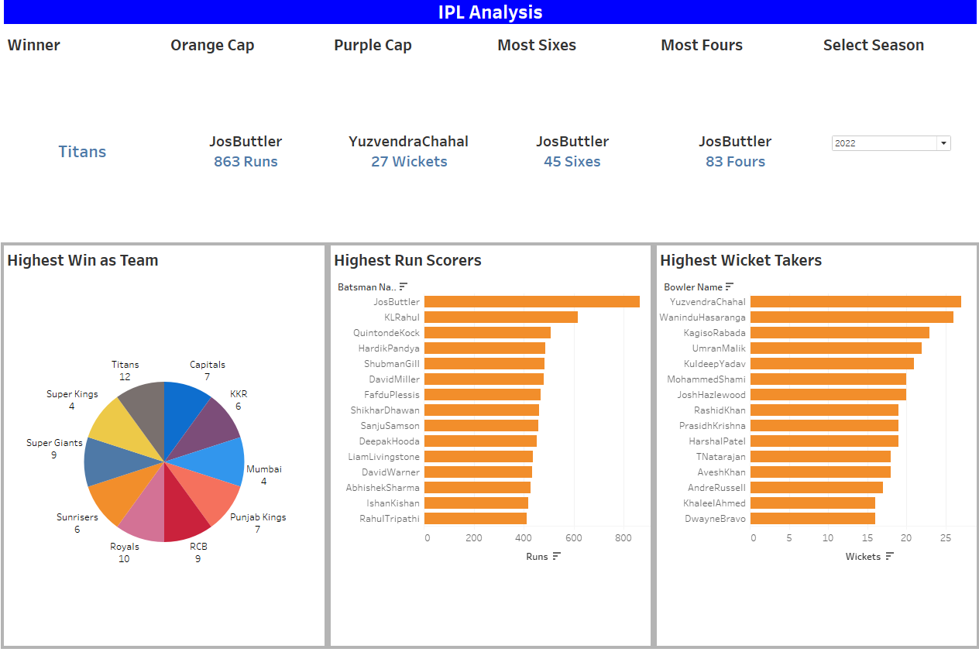

Slide 5
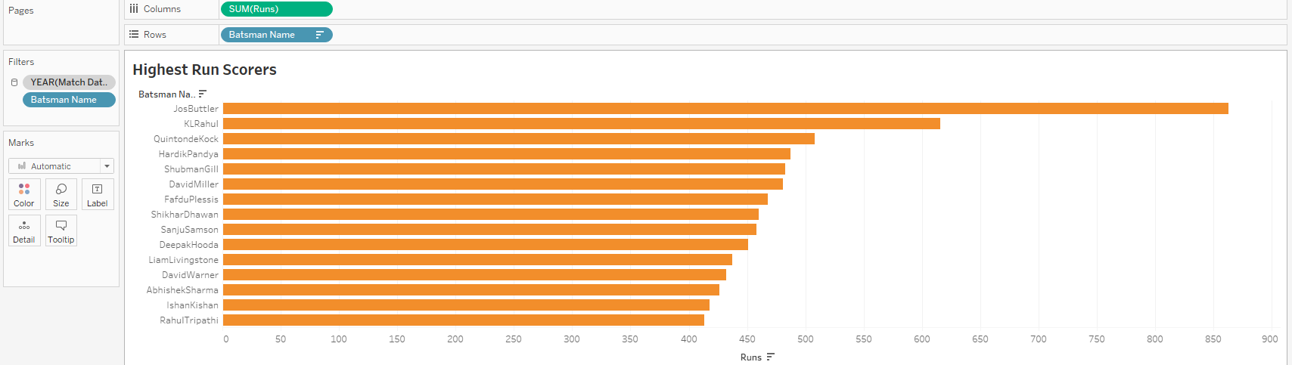
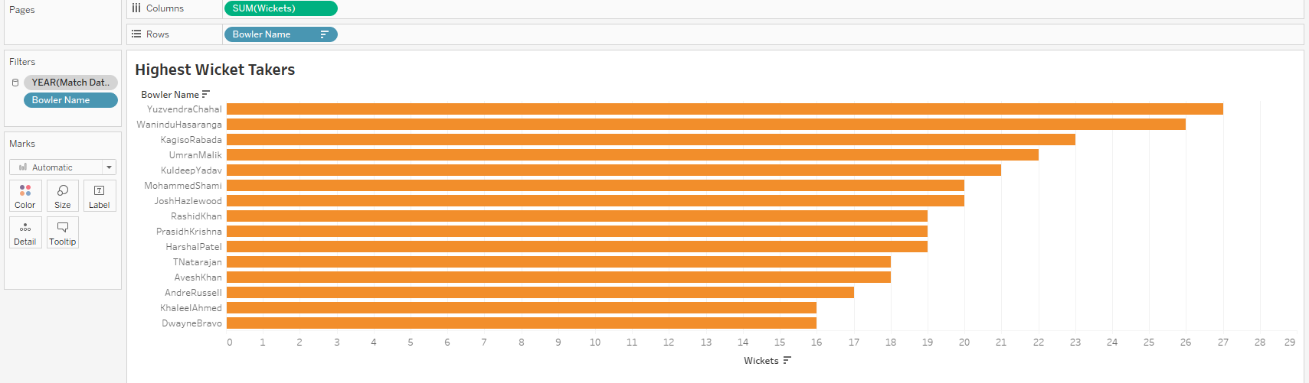

Slide 6
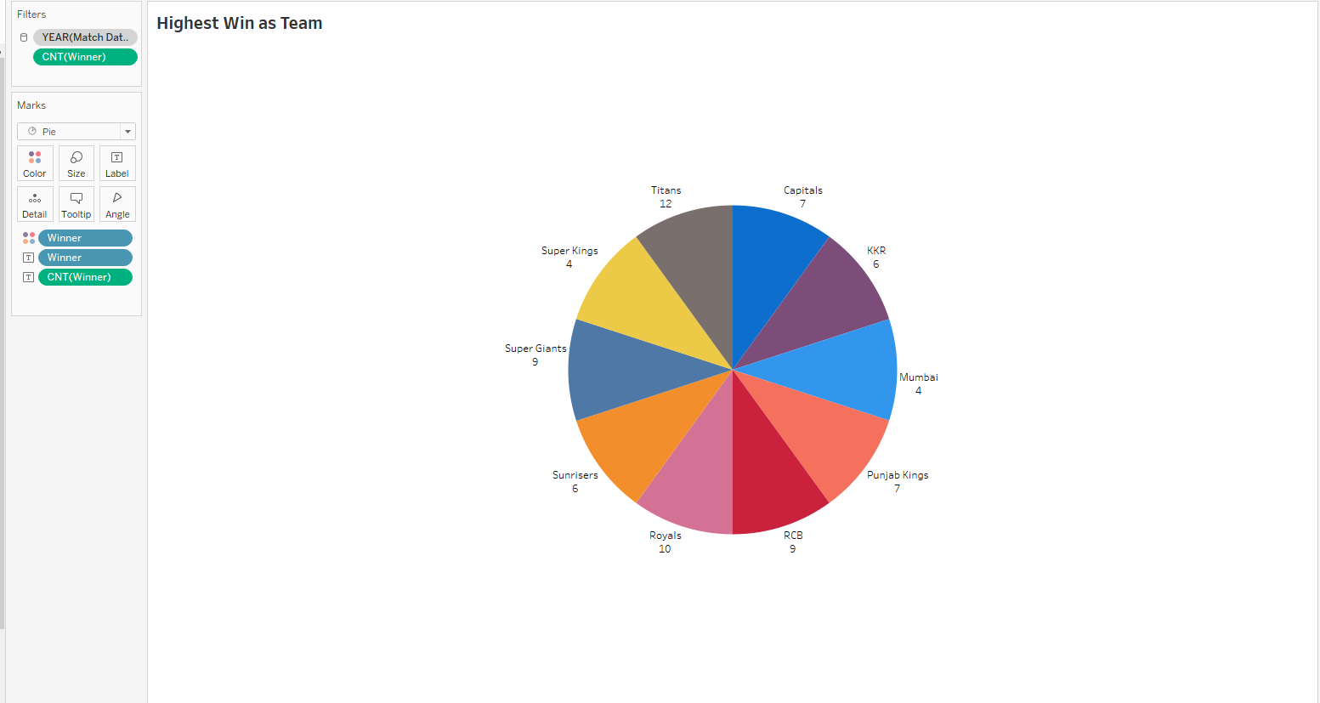

Slide 7
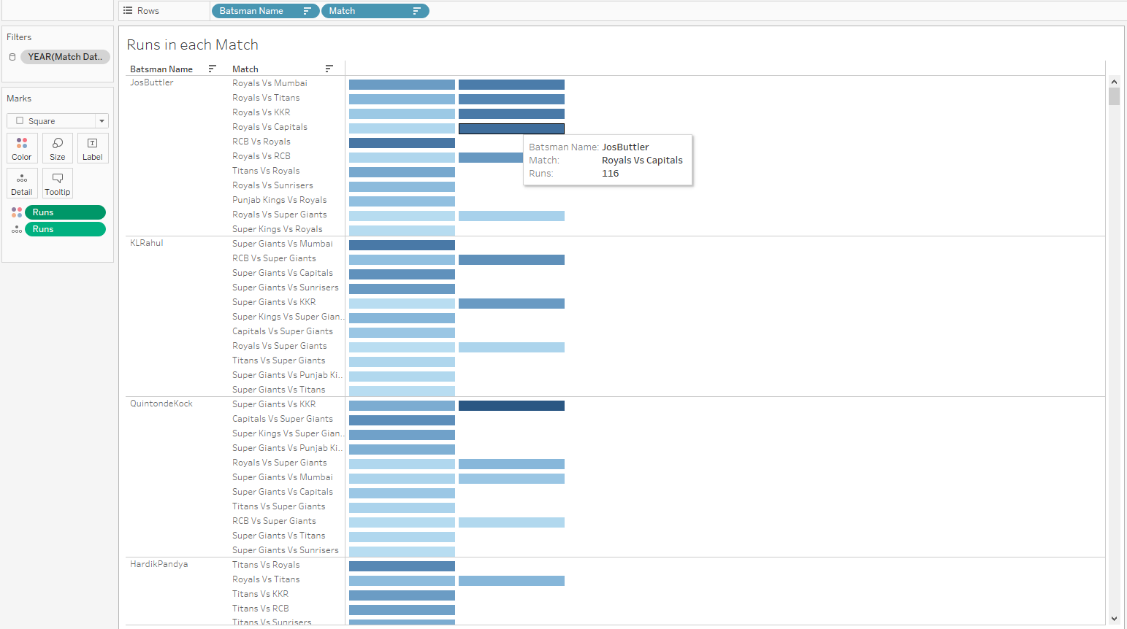

Slide 8
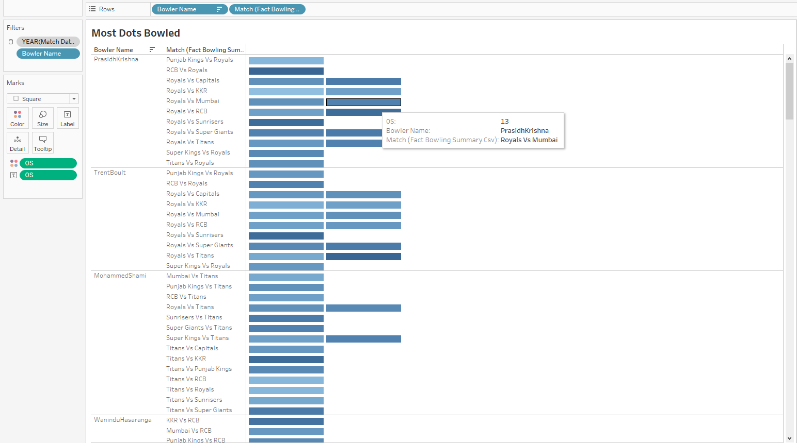

Slide 9
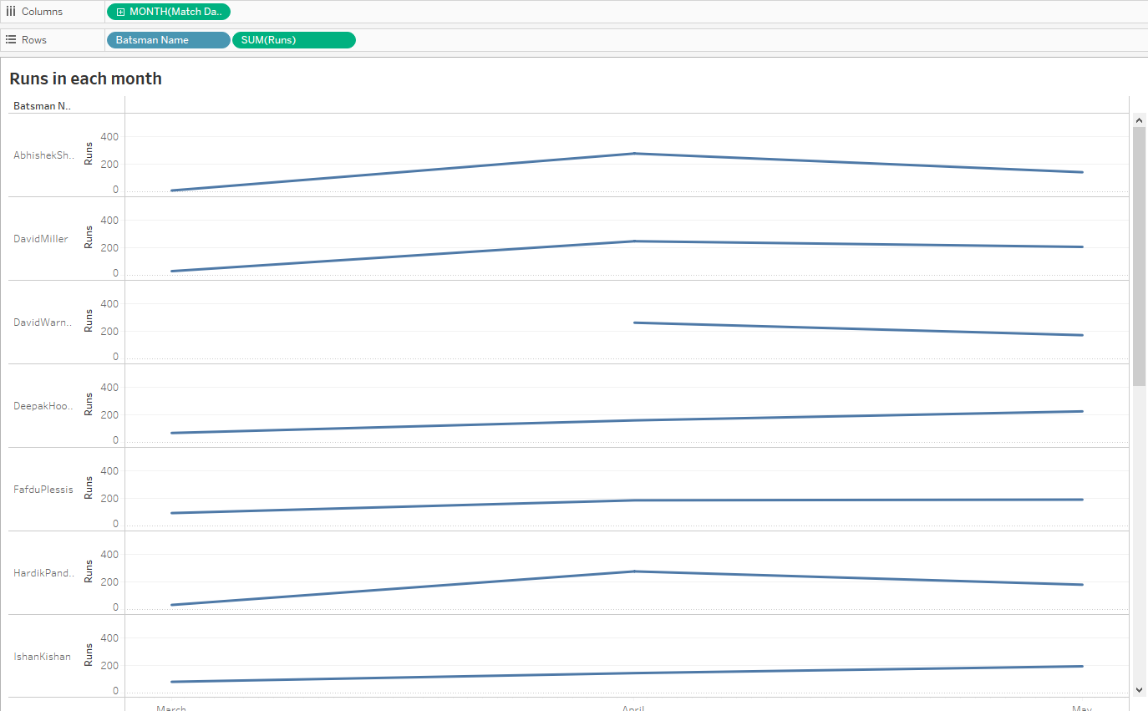

Slide 10
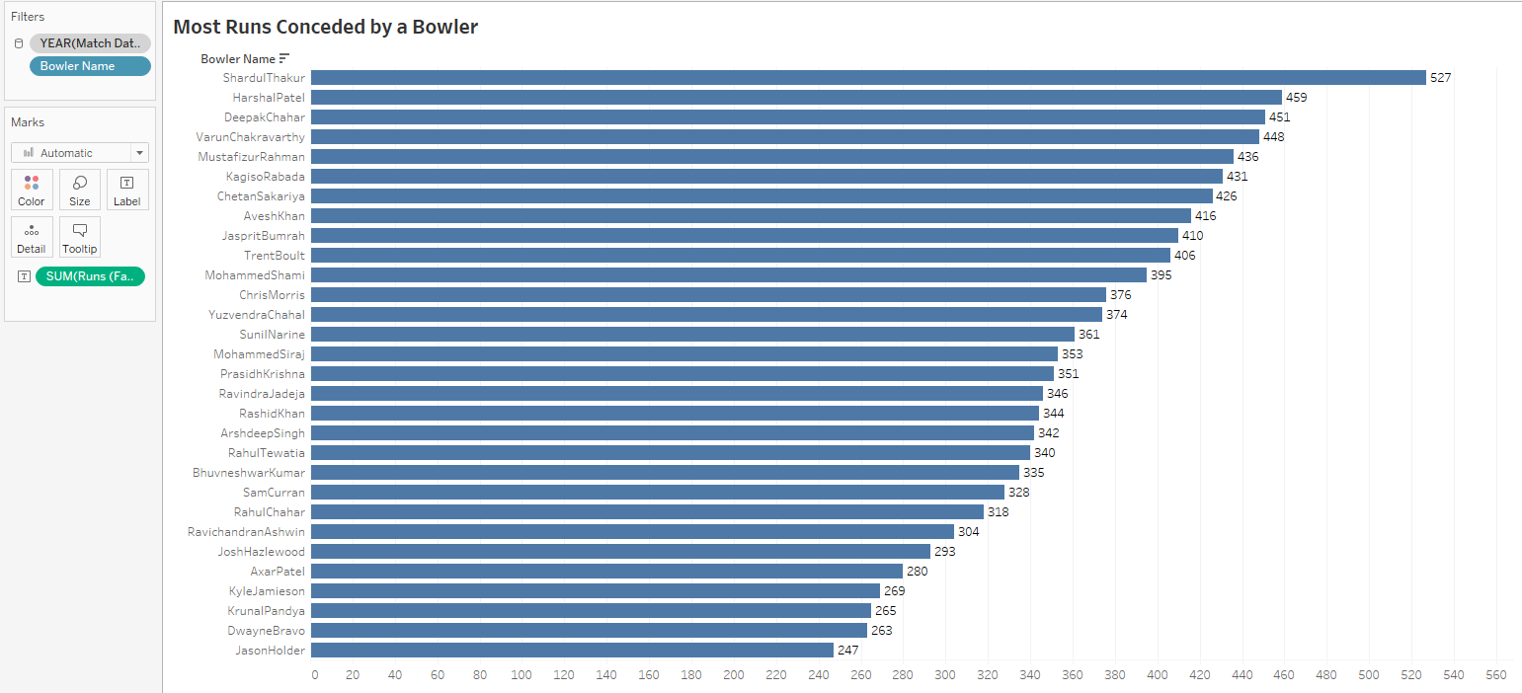

Slide 11
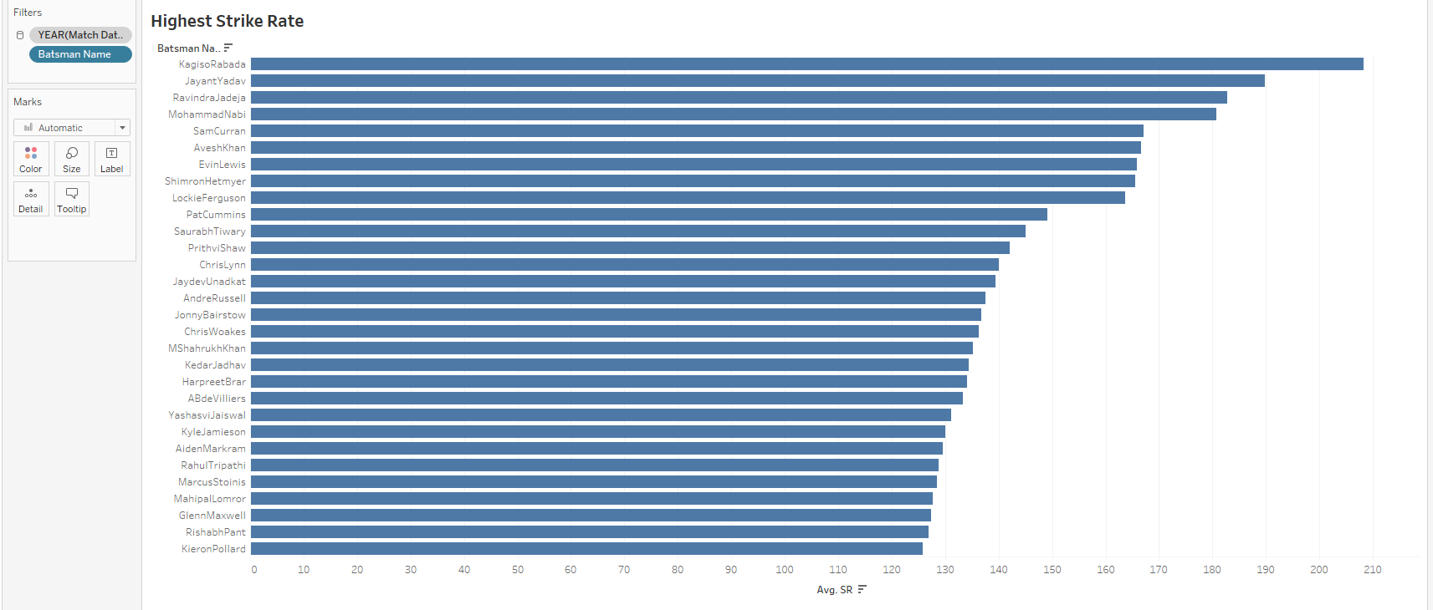

Slide 12
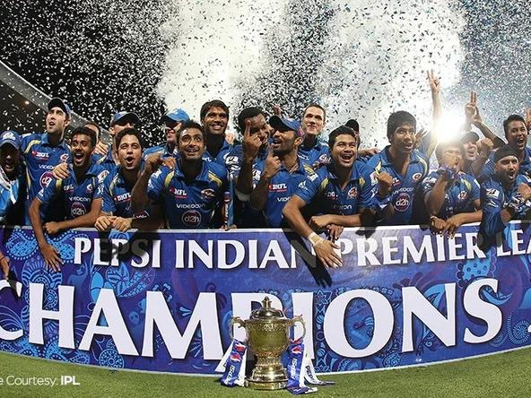
THANK
YOU

